Slide 1
A Study of MIRCERA® for the Maintenance Treatment of Dialysis Patients With Chronic Kidney Anemia.
Group 13: Madeline Clark, Robert Cohen, Leah Goldwaser, Dennis Keo, Sara Nguyen, and Danielle Derosa
Notes:
https://clinicaltrials.gov/study/NCT00517413?cond=dialysis&aggFilters=phase:3%204,results:with,status:com&term=latino&rank=1

Slide 2
What is a Dialysis?
Intervention: Dialysis
What is dialysis? Dialysis is a type of treatment that helps your body remove extra fluid and waste products from your blood when the kidneys are not able to it on its own. Type of Dialysis?
Two types of dialysis: Hemodialysis & peritoneal dialysis

Slide 3
Dialysis

Slide 4
How do you get on dialysis?
End Stage Renal Failure
How to determine if patient needs to receive Dialysis
What is adequate hemoglobin
concentration?
There are 5 stages of kidney disease. A patient has to be in their final stage of chronic kidney disease, where there is a decline in kidney function. They kidney can not function on their own without dialysis or a kidney transplant.
It can be diagnosed by urine test, kidney ultrasound, biopsy or a blood test testing hemoglobin concentration.
Hemoglobin is the amount of oxygenated blood that is transported throughout the body. The lower the concentration, the more susceptible the patient is to anemia. Male: 13.2 - 16.6g/dL Female: 11.6 -15g/dL
Notes:
What is the connection between dialysis and anemia

Slide 5
How does dialysis combate anemia?
Filter & remove blood waste
Introduce medication & supplement:
Iron supplement - need to make hemoblogin
Erythropoietin (EPO) stimulating agent - produce red blood cells
Filter & remove blood waste
Introduce medication & supplement:
Iron supplement - need to make hemoblogin
Erythropoietin (EPO) stimulating agent - produce red blood cells
Notes:
Talk about hemoglobin concentration and hemoglobin

Slide 6
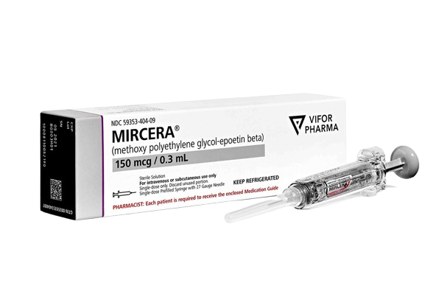
MIRCERA® Treatment
What is MIRCERA® ? MIRCERA® is a long-acting hormone stimulant in the kidney to produce more red blood cell to combat anemia. Administered: Intravenously (IV) or Subcutaneous injection (SC).
Efficacy: Established was based on the change in hemoglobin concentration between the initial and the evaluated hemoglobin observed evaluated period.
Cost: US $300-$1000 depending on dosage Clinical trial dosage: 120/200/360 mcg
Notes:
Side effects
Physiology - move it up
What is measured: hemoglobin

Slide 7
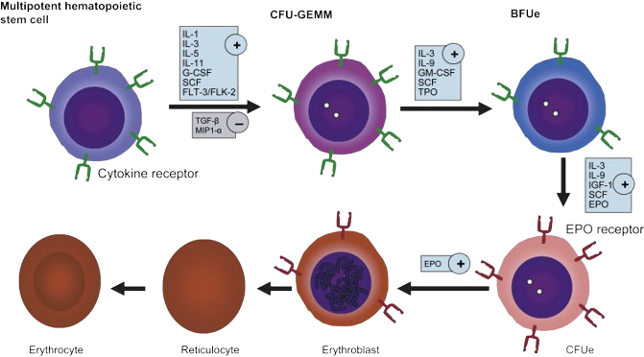
Mechanism of Action/Physiology of Intervention
An ESA is an Erythropoiesis Stimulating Agent that when injected either intravenously or subcutaneously, stimulates the bone marrow to further the promote the red blood cell production.
Notes:
Erythropoiesis is the body's process of producing red blood cells. Since the chronic renal anemic patients are in dire need of red blood cells, an ESA is injected into the body.

Slide 8
Study Goals and Objectives
Study Goal
Objective
The study goal is assessing the efficacy and safety of MIRCERA® when administered once monthly, subcutaneously (SC) or intravenously (IV) for the maintenance of hemoglobin levels in dialysis patients with chronic renal anemia.
The study objective is finding out if administering MIRCERA® will keep hemoglobin levels steady in dialysis patients with chronic renal anemia.

Slide 9
Primary Measurable Outcome
The primary measurable outcome is the percentage of participants maintaining their mean hemoglobin concentration with a +/- 1.0 gram/deciliter of their reference hemoglobin and between 10.5-12.5 gram/deciliter.
Notes:
Move up

Slide 10
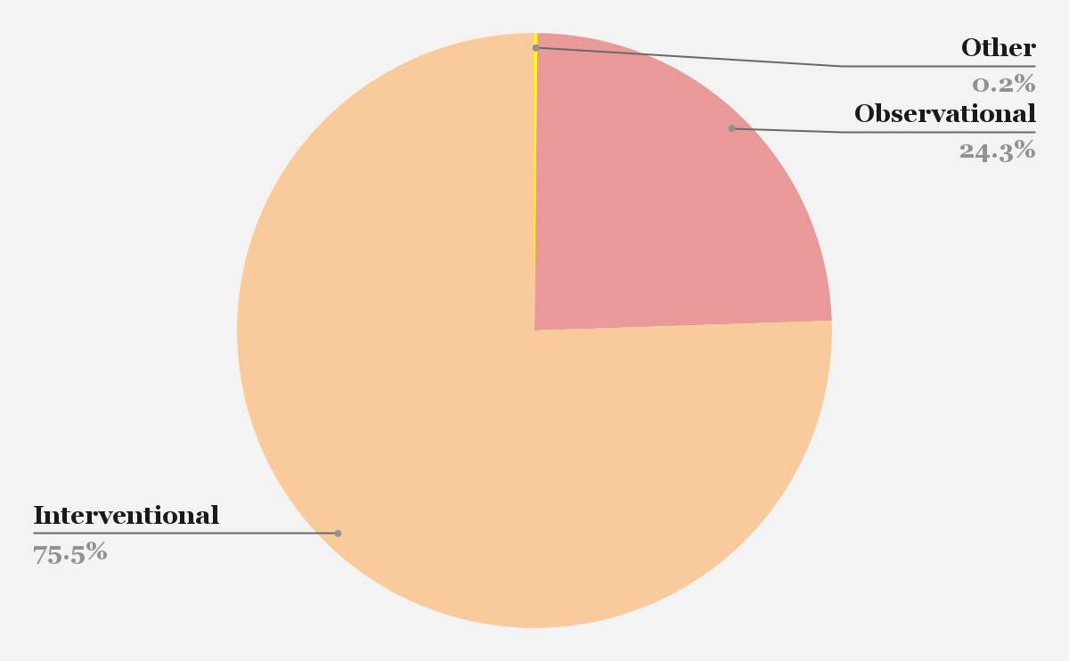
Database Analysis by Study
Based on the other Clinical Trials studying the topic Dialysis
Types of Studies | Number of Clinical Trials
All Clinical Studies | 1,920
Interventional Clinical Studies | 1,450
Observational Clinical Studies | 467

Slide 11
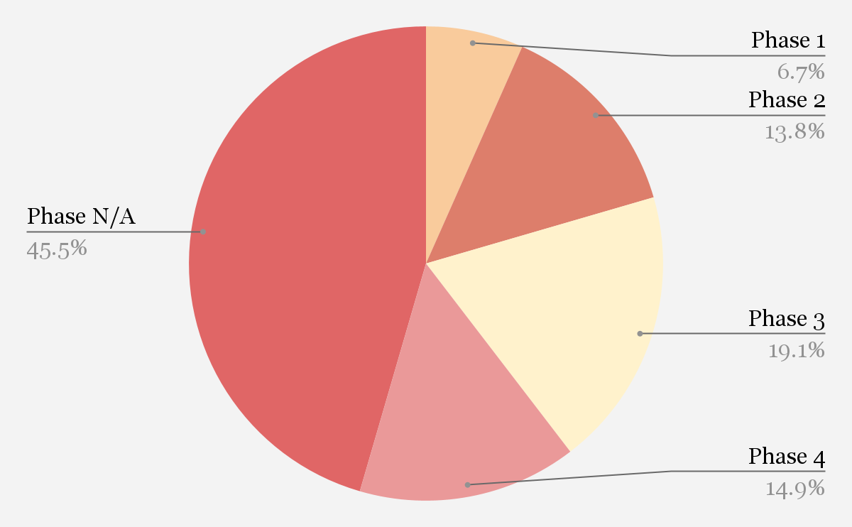
Data Analysis by Phase
Based on the other Clinical Trials studying the topic Dialysis
Phases | Number of Clinical Trials
Phase 1 | 99
Phase 2 | 206
Phase 3 | 284
Phase 4 | 222
Phase N/A | 677

Slide 12
Initial General Measure of the Trial
Latinx community from Mexico, Brazil, Argentina, Uruguay, Chile, Colombia, Ecuador, Peru, & Venezuela.
3-12 months, one-month injection
Target sample size: 100-500. Actual 163 Inclusion Criteria:
adult patients, >=18 years of age;
chronic renal anemia;
hemodialysis or peritoneal dialysis, with same mode of dialysis for >=3 months before and throughout screening period;
stable maintenance epoetin alfa therapy for past 2 months.
Exclusion Criteria:
transfusion of red blood cells during previous 2 months;
poorly controlled hypertension requiring interruption of epoetin alfa in past 6 months;
acute or chronic bleeding during previous 2 months.

Slide 13
Study design
Latino Study: A Study of MIRCERA® for the Maintenance Treatment of Dialysis Patients with Chronic Renal Anemia.
Study information
Inclusion Criteria
Exclusion Criteria
Start/End date: 10/2007-05/2010
Participants: 261 screened only 163 accepted
Eligibility: 18 years or older, male or female
Phase type: Phase 3
Study type: Interventional
Masking: no masking
Intervention model: single group assignment
Primary Purpose: Treatment
Drug: Mircera;120,200,360 micrograms;sc or Iv monthly
Placebo: no placebo given
Adult patients
Chronic renal anemia
Hemodialysis or peritoneal dialysis
Stable maintenance epoetin alfa therapy for the past 2 months
Transfusion of RBCs during previous 2 months
Poorly controlled hypertension requiring interruption of epoetin alfa in the past 6 months
Acute or chronic bleeding during the previous 2 months
Notes:
Go through information and bold important parts. This slide is better than the other one. Put what dose of the medication was given

Slide 14
Participant Information
263 participants screened
161 enrolled and started
61 didn't complete the study
102 completed the study
Notes:
Write what doses were given.

Slide 15
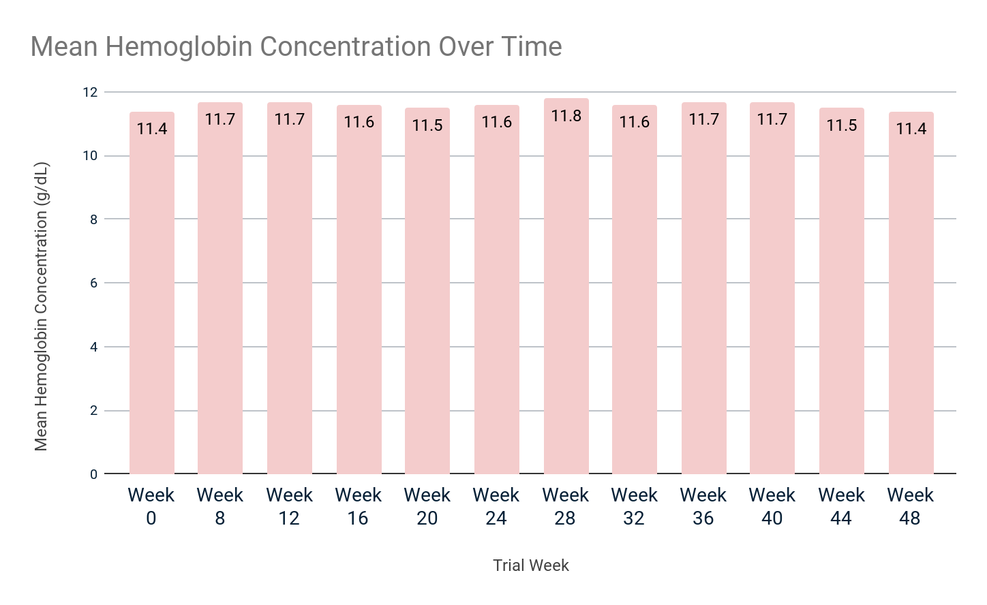
Primary Outcome Results Illustration
*There is no placebo group. The results shown are the hemoglobin concentration of the experimental group given MICERA

Slide 16
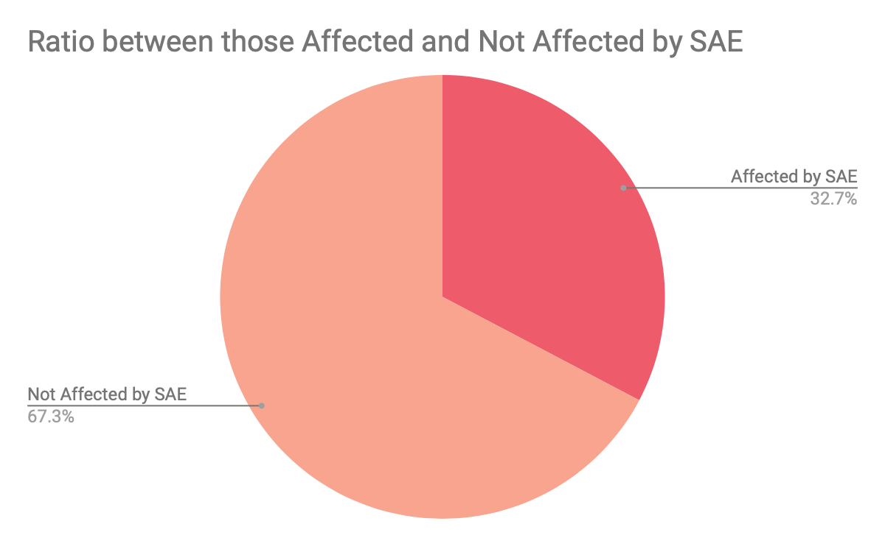
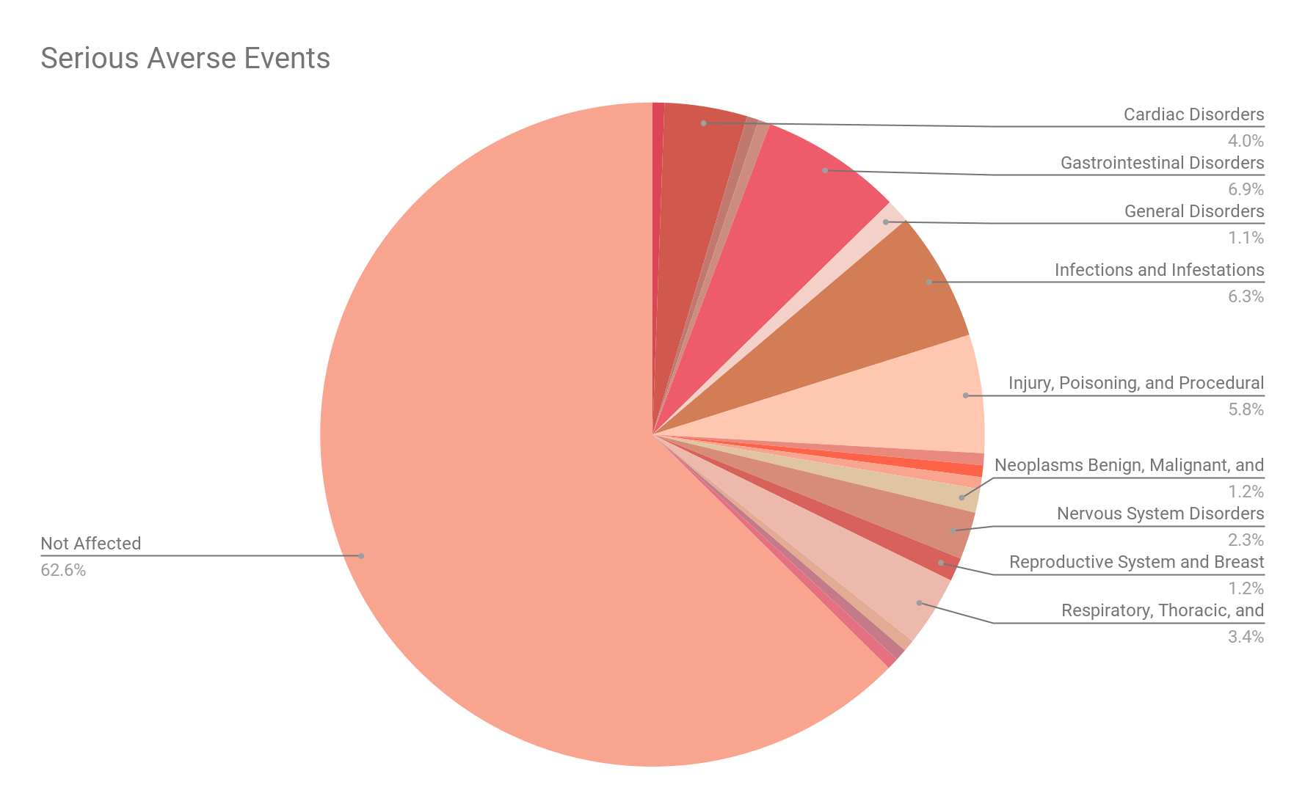
Serious Adverse Events Illustration
Of the 162 participants, 53 participants experienced serious adverse events (SAE). The most notable SAEs were gastrointestinal hemorrhage (3/162), pneumonia (5/162), and arteriovenous fistula thrombosis (5/162).
Notes:
No placebo so cant check sae.

Slide 17
Interpretation of the Clinical Trial
Although there was no p-value included in the study, it can be determined that the MIRCERA® Treatment stabilized the hemoglobin levels of the patients.
Average hemoglobin levels: 12-18 g/dl
12-16 g/dl for females
14-18 g/dl for males
Adverse side effects for the patients heavily varied, but did not show many significant threats to an individual's health.
Most of the side effects listed only impacted 1 out of the 162 participants.
The most noteworthy side effect was Pneumonia (5 out of 162)

Slide 18
Article One: Treatments Response in Dialysis Anemia
Two Supplemental Articles:
Drugs used: Iron Sucrose or Erythropoietin Stimulating Agent (Epoetin Beta)
Length of Study: 73 weeks
Number of participants: 160 subjects (76 receiving Iron Sucrose and 84 receiving Erythropoietin Stimulating Agent).
Classification: Both groups were previously treated with Epoetin Beta, except that one group started to receive 1 gram of Iron sucrose if their hemoglobin was less than 9.5 g/dL instead of the previously used ESA.
Primary Outcome Measure: Hemoglobin increase of greater or equal to 5g/L
Serious Adverse Events: Iron Sucrose- 19.32% Epoetin Beta- 21.88%
Results:
The mean hemoglobin concentration in patients who still received the ESA was higher than in the Iron Sucrose group.
There were an increase in serious adverse events for the ESA group.
Although the mean hemoglobin concentration is increased for the ESA users which is the goal, the possibility of serious adverse events makes it debatable to use.
Notes:
Conclusions - a higher dosage of ESA may inflict a resistant response to the body causing higher mortality. PD ESA resistance seems to have less of an effect compared to HD resistance. Write what dose of this medication was given.
Move these before recommendations
Need something on anemia/ erythropoesis

Slide 19
Article Two:
Safety and Efficacy of Peginesatide for Maintenance Treatment of Anemia in Participants with Chronic Kidney Disease on Hemodialysis
Two Supplemental Articles:
Drug used: (starting dose is based off the participants most recent ESA dose) Peginesatide and Epoetin Beta.
Length of overall study: 98 weeks
Number of participants: 568 (366 injected with Peginesatide, 202 injected with Epoetin Beta)
Primary Outcome Measure: Mean change in Hemoglobin levels between Baseline and Evaluation period
Results:
Change of baseline hemoglobin levels for Peginesatide (-0.24) and for Epoetin Beta (-0.09).
Serious Adverse Events for Peginesatide (58.02%) and Epoetin Beta (62.45%)
Although Epoetin Beta assists with keeping hemoglobin levels stable compared to Peginesatide, the serious adverse events are once again very prominent.
Notes:
Mircera is a long acting esa (less frequent) compared to epoetin beta which is a short acting drug (more frequent). Compare those details with out study

Slide 20
Recommendations on Results
No placebo
Without a placebo there are no results to compare it to.
We do not really know if the adverse effects are a direct correlation to administering MIRCERA®
Missing Information
We do not know anything about the patients like:
Diet
Exercise habits
No p value
Without a p value it is difficult to verify whether evidence discovered in the sample can be extended to another independent sample
Notes:
No placebo
Diet exercise
Different stages
Different diseases that impact anemia

Slide 21
Recommendations on Results
Different Stages
There are different stages of renal anemia and the study does not take that into account. It just generalizes renal anemia.
Notes:
No placebo
Diet exercise
Different stages
Different diseases that impact anemia

Slide 22
Should MICERA be Used to Treat Dialysis Patients?
Benefits of MIRCERA®
Flaws of the Study
As indicated by the study results, MIRCERA® was successfully able to maintain stable hemoglobin levels within the participants.
Although there were many serious adverse events prevalent, there were not patterns showing that MIRCERA® caused them.
Long-acting ESA.
No Placebo Group
No comparison for drug efficacy
No comparison for S.A.E
No P-Value
Study done only on a Latino Population
Although the results show that MIRCERA® is effective at keeping hemoglobin levels stable, the study itself is not a good representation of its efficacy.

Slide 23
Next Steps
As a group we believe more trials have to be done before recommending Micera for the maintenance treatment of Dialysis Patients with Chronic Renal Anemia.
The range for hemoglobin levels had to remain between 10.5-12.5 and as seen from the results the mean hemoglobin levels for all participants remained no lower and no higher than 11 through the 48 weeks. However…
More Clinical Trials are Needed.
There was no P-value to reference in the study.
There was no placebo and no control group, making it impossible to compare results.
There was a lack of information explaining if the patients who had adverse effects during the study, had signs prior as well.
Until further research can be done, alternative ESAs should continue to be used.
Notes:
Mention lack of control group. Should just get straight to the point. Would we or would we not recommend it?

Slide 24
Resources
Introduction
Mircera (methoxy polyethylene glycol-EPOETIN beta). (n.d.). https://www.ema.europa.eu/en/documents/overview/mircera-epar-summary-public_en.pdf
professional, C. C. medical. (n.d.). Kidney failure: Causes, symptoms & treatment. Cleveland Clinic. https://my.clevelandclinic.org/health/diseases/17689-kidney-failure
What is dialysis?. National Kidney Foundation. (2023, November 1). https://www.kidney.org/atoz/content/dialysisinfo
What is Mircera®?. Welcome to MIRCERA®. (n.d.). https://mircera.com/
EDUCATE YOUR DIALYSIS PATIENTS ABOUT ANEMIA. https://www.kidney.org/sites/default/files/12-10-4750_DBC_AnemiaManage_TalkingPoints_11F.pdf
Mechanism/Physiology intervention
Del Fabbro P;Luthi JC;Carrera E;Michel P;Burnier M;Burnand B; (n.d.). Anemia and chronic kidney disease are potential risk factors for mortality in stroke patients: A historic cohort study. BMC nephrology. https://pubmed.ncbi.nlm.nih.gov/20950484/
2 supplemental articles
“ClinicalTrials.gov.” Clinicaltrials.gov, clinicaltrials.gov/study/NCT02707757?cond=dialysis%20anemia&aggFilters=phase:3%204. Accessed 12 Feb. 2024.
ClinicalTrials.gov. (n.d.). https://clinicaltrials.gov/study/NCT00597753?cond=ESA&term=DIALYSIS%20&aggFilters=results:with,status:com,studyType:int&page=2&rank=13&tab=results
Mircera prices, coupons, Copay & Patient Assistance. Drugs.com. (n.d.-a). https://www.drugs.com/price-guide/mircera
End stage renal disease (ESRD). Johns Hopkins Medicine. (n.d.-b). https://www.hopkinsmedicine.org/health/conditions-and-diseases/end-stage-renal-failure#:~:text=Overview,longer%20function%20on%20their%20own

Slide 25
Resources con’t
Primary Measurable Outcome
C;, A. (n.d.). The primary outcome measure and its importance in clinical trials. The Journal of clinical psychiatry. https://pubmed.ncbi.nlm.nih.gov/26528658/#:~:text=The%20primary%20outcome%20measure%20is,time%20the%20study%20is%20designed
Video
YouTube. (2020, February 25). Renal replacement therapy: Hemodialysis vs peritoneal dialysis, animation. YouTube. https://www.youtube.com/watch?v=SgBMoCArNak

